Slide 1


Lecture 8: Convolution Networks and Autoencoders
Pavlos Protopapas

Slide 2
Image Data
Fully-connected nets infeasible
E.g. 1K x 1K image (1 million pixels)
No. of parameters blow up
Convolution Nets
Exploit image structure
Use sparse weights between layers

Slide 3
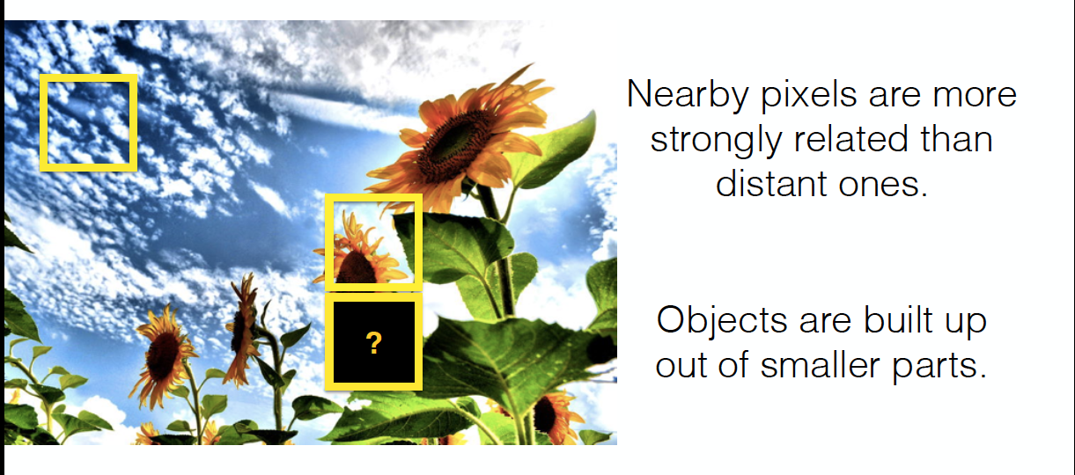
Images are Local and Hierarchical

Slide 4
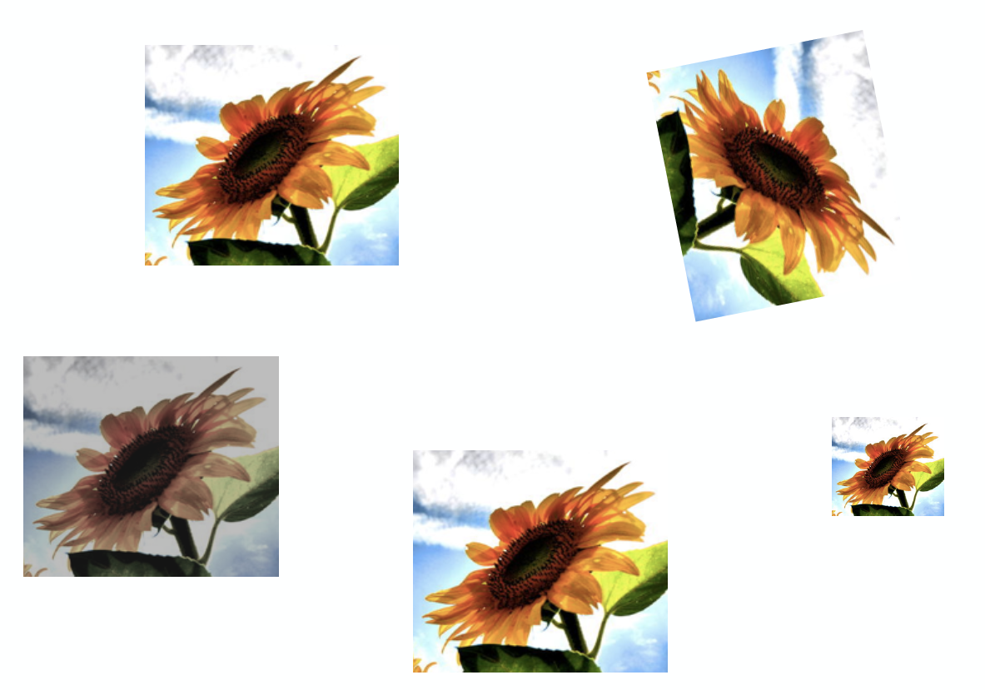
Images are Invariant

Slide 5
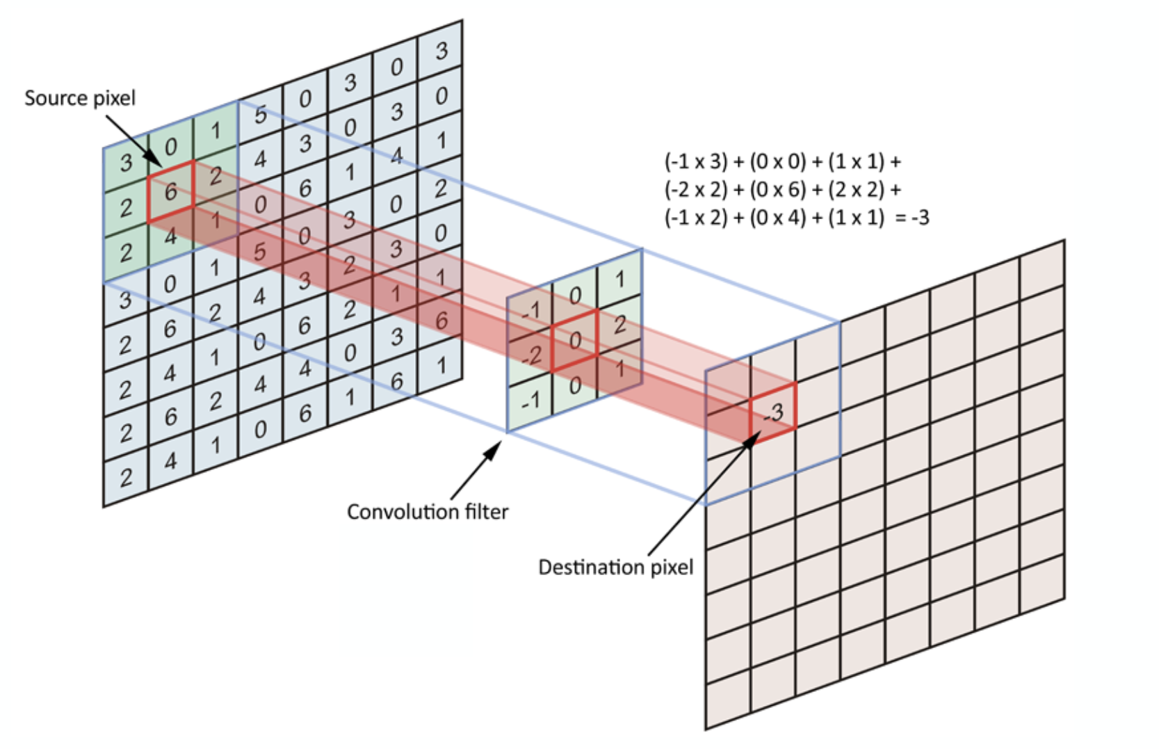
“Convolution” Operation

Slide 6
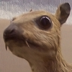
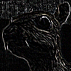
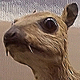
“Convolution” Operation
Kernel
Edge detection
*
=
Sharpen
*
=
wikipedia.org

Slide 7

A Convolutional Network
+ ReLU
+ ReLU

Slide 8
Key Features
Sparse interaction
Parameter sharing
Pooling
Zero padding

Slide 9
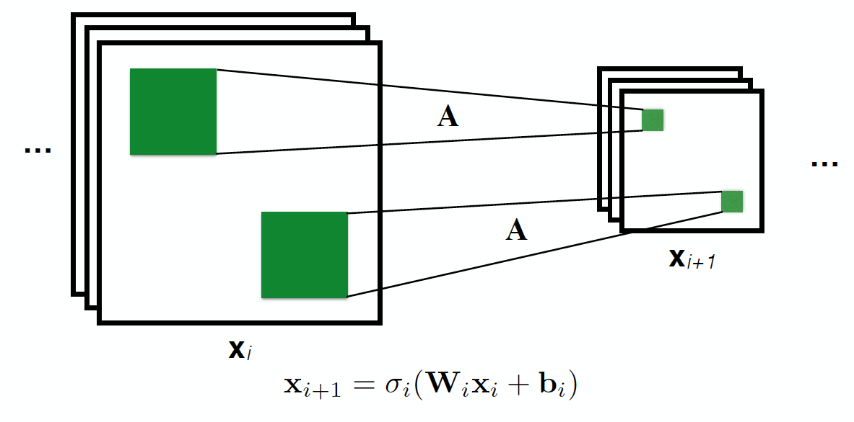
Sparse Interactions
Each output interacts to a small region of inputs

Slide 10
Sparse Interactions
Kernel size smaller than input
Image: usually millions of pixels
Kernel: usually 100s or 1000s of parameters
Reduced memory and run-time, improved statistical efficiency
O(m × n) => O(k × n) parameters

Slide 11
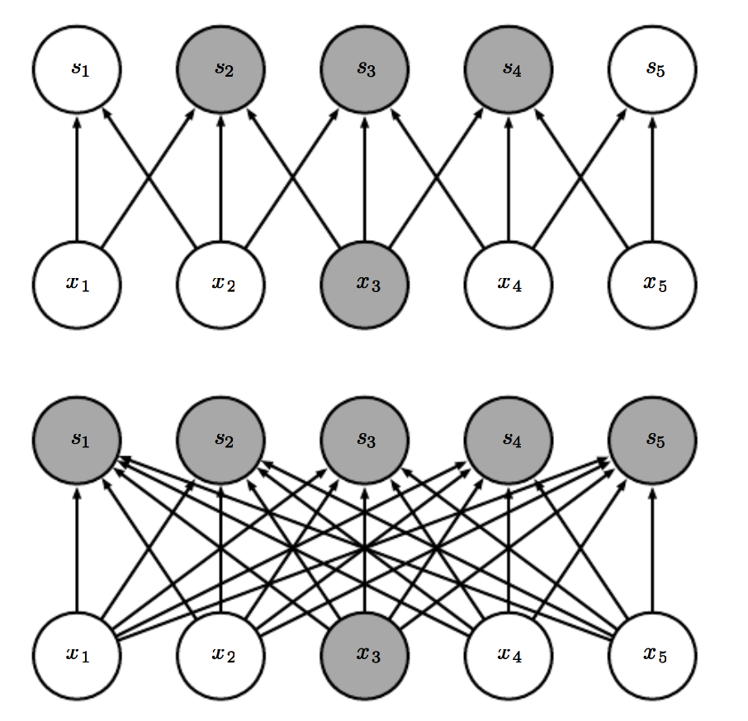
Sparse Interactions
Convolutional
Fully-connected

Slide 12
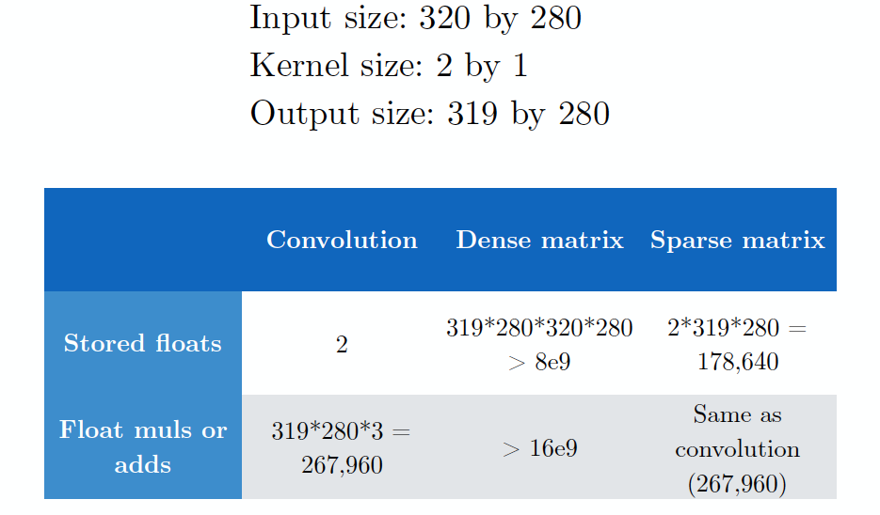
Computational Costs

Slide 13
Key Features
Sparse interaction
Parameter sharing
Pooling
Zero padding

Slide 14
Parameter Sharing
Same A in different locations – only learn A

Slide 15
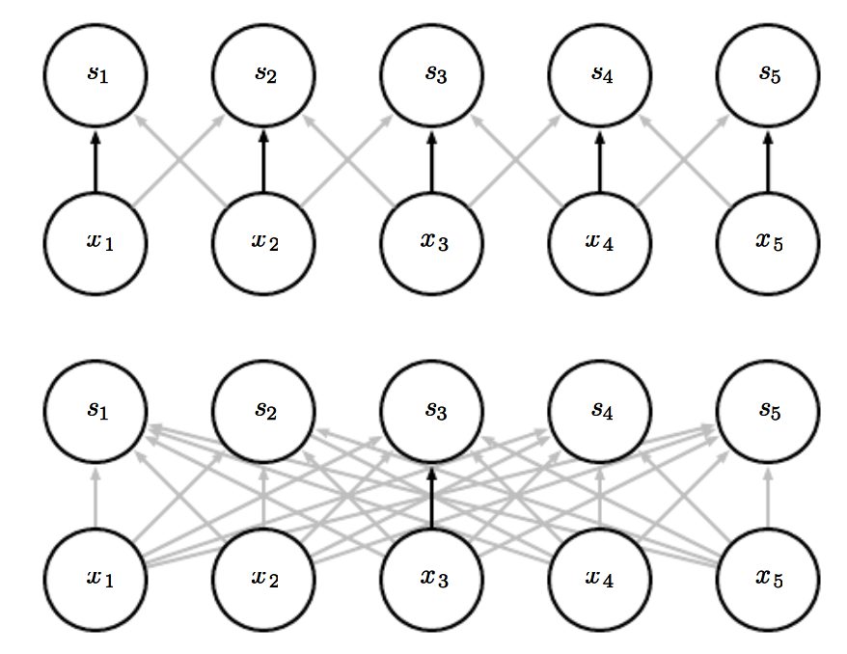
Parameter Sharing
Convolutional
Fully-connected

Slide 16
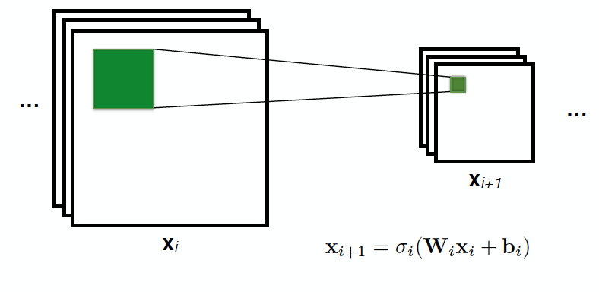
Parameter Sharing
Equivariant to translation

Slide 17
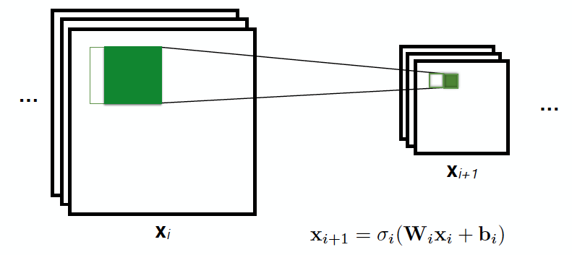
Parameter Sharing
Equivariant to translation

Slide 18
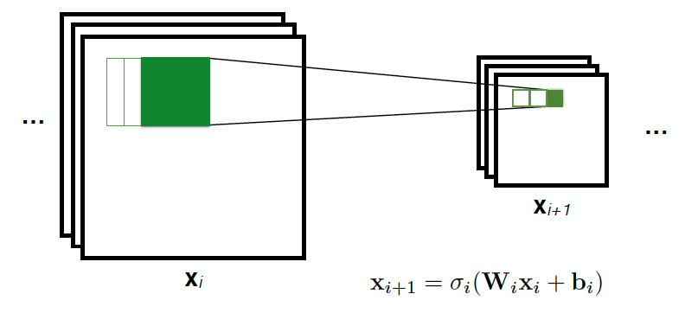
Parameter Sharing
Equivariant to translation

Slide 19
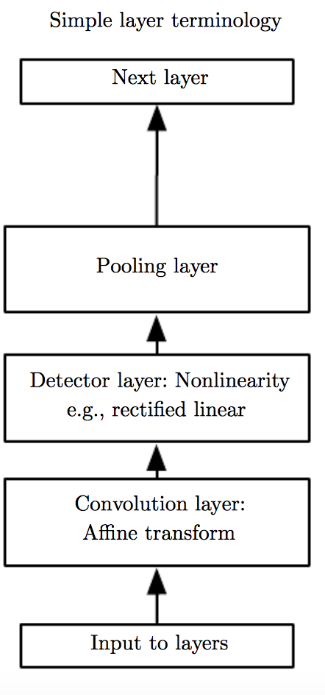
Non-linear activation

Slide 20
Key Features
Sparse interaction
Parameter sharing
Pooling
Zero padding

Slide 21
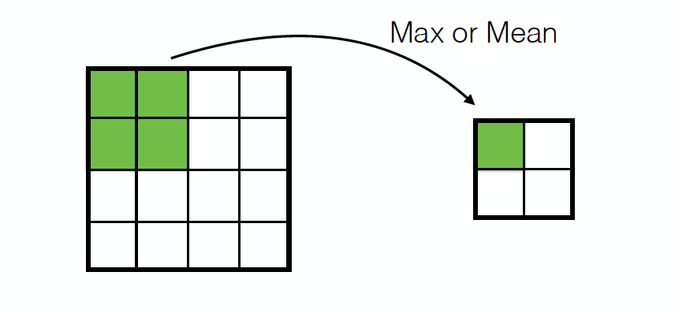
Pooling

Slide 22
Pooling
Invariant to small, “local transitions”
Face detection: enough to check the presence of eyes, not their precise location
Fewer pooling units than detector units
Reduces input size to final fully connected layers

Slide 23
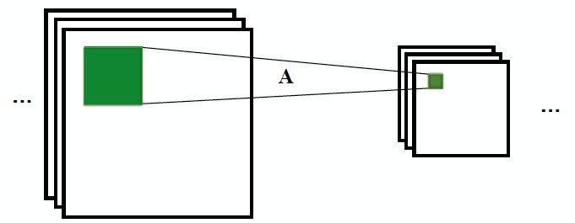
Multiple Channels
ConvNets can have multiple channels a.k.a. feature maps, each with separate parameters

Slide 24
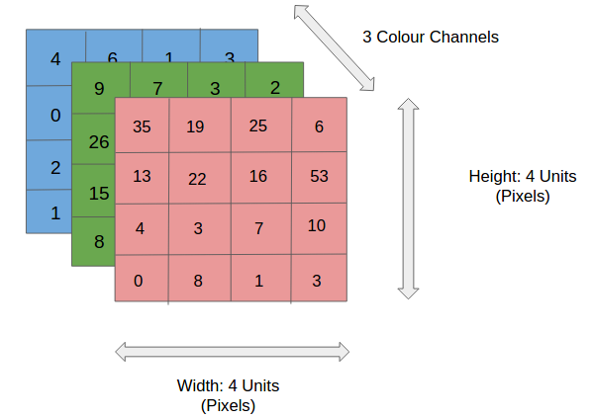
Multiple Dimensions
Multiple Channels: 4th axis
4D Tensor
wxrds.acm.org

Slide 25
Overall Architecture
+ ReLU
+ ReLU

Slide 26
Key Features
Sparse interaction
Parameter sharing
Pooling
Zero padding

Slide 27

No Padding
Representation size shrinks by ‘kernel width – 1’ after each layer
Ignores large portion of input image
deeplearning.net
Notes:
http://xrds.acm.org

Slide 28

Same Padding
Pad zeros so that output is same size as input
deeplearning.net
Notes:
http://xrds.acm.org

Slide 29

Full Padding
Pad zeros so that every pixel is visited same number of times
Increases computation and storage cost
deeplearning.net
Notes:
http://xrds.acm.org

Slide 30

Padding with Strides
Shift the kernel not by 1 pixel, but by k pixels (stride)
Stride = 2
Sees entire image, but low computational and storage costs
deeplearning.net
Notes:
http://xrds.acm.org

Slide 31
Key Features
Sparse interaction
Parameter sharing
Pooling
Zero padding

Slide 32
Back-propagation
Propagate image forward
+ ReLU
+ ReLU
Propagate gradients backward
Notes:
http://www.jefkine.com/general/2016/09/05/backpropagation-in-convolutional-neural-networks/

Slide 33
Back-propagation
Forward pass through a convolution unit
Output: 2 × 2
Kernel: 3 × 3
Input: 4 × 4
deeplearning.net

Slide 34

Back-propagation
Backward pass = transpose convolution
Output: 4 × 4
(gradient for layer L)
Kernel: 3 × 3
Input: 2 × 2
(gradient for layer L-1)
deeplearning.net

Slide 35
Back-propagation
Parameter matrix W contains offset copies of the kernel matrix (Toeplitz matrix)
Parameter matrix for the transpose convolution is W^{T}
(forward)
(backward)

Slide 36
ConvNet Variants
Locally-connected Layers
No parameter sharing, learn separate weights for each spatial location
Useful when each output needs to be a function of a small part of the input
Tiled Convolution
Learn set of kernels, rotate them through space
Neighboring locations have different filters

Slide 37
Autoencoders

Slide 38
Supervised Learning
Given: (x, y)
Goal: Learn a mapping h: X -> Y

Slide 39
Unsupervised Learning
Given: x
Goal: Discover hidden structures from data

Slide 40
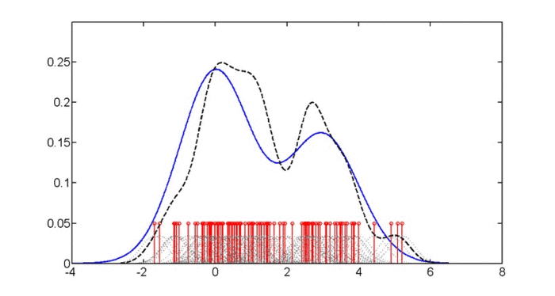
Example: Density Estimation
Estimate probability density p(x) from observations {x₁, …, x_{m}}

Slide 41
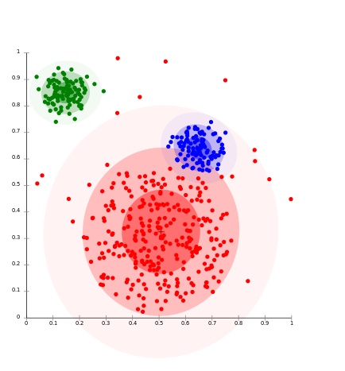
Example: Clustering
Group data points based on similarity

Slide 42
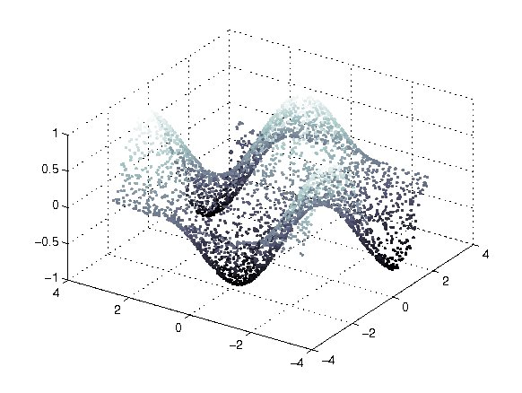
Example: Representation Learning
Data lies on a low-dimensional manifold
Notes:
http://people.kyb.tuebingen.mpg.de/mmaier/ManifoldDenoising.html

Slide 43
Linear Factor Model
h: Explanatory factors / latent variables
Goal: Infer h for a given x
Used as features for a learning task

Slide 44

Probabilistic Principal Component Analysis
Notes:
wiki

Slide 45
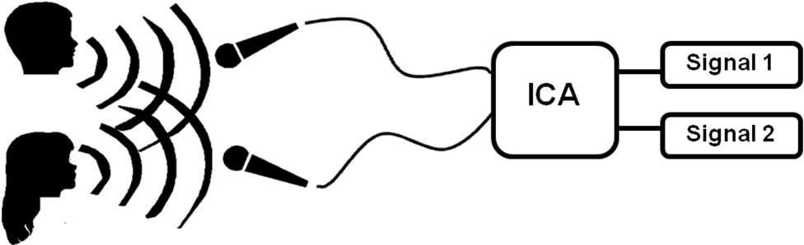
Independent Component Analysis
h is drawn from a non-Gaussian distribution
E.g. audio signal separation
Notes:
https://archive.cnx.org/contents/ef687871-4da1-461c-95b0-c6be9dd1181d@2/blind-source-separation-via-ica-implementation

Slide 46

Beyond Linear: Autoencoders
Neural net that approximately copies its input to output
Encodes useful info about data
Notes:
https://blog.keras.io/building-autoencoders-in-keras.html

Slide 47
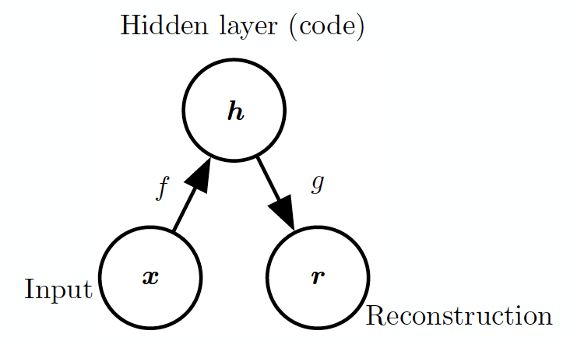
Structure of Autoencoders

Slide 48
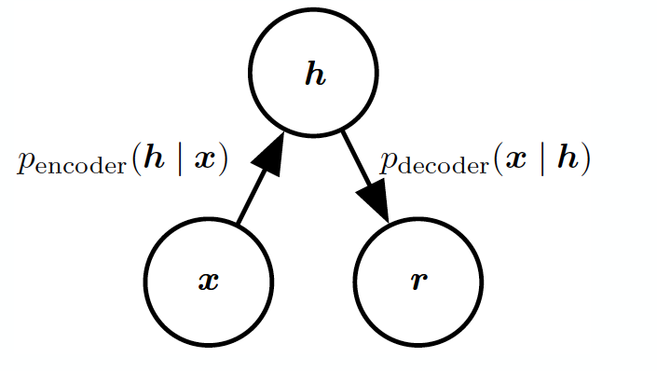
Stochastic Autoencoders

Slide 49
Undercomplete Autoencoders
h has lower dimension than x
Must discard some information in h
Learning involves minimizing loss:
Equivalent to PCA when f is linear, L is MSE

Slide 50
Overcomplete Autoencoders
h has greater dimension than x
Autoencoder may simply copy input to output without learning anything useful
Regularization to limit model capacity

Slide 51
Regularized Autoencoders
Sparse autoencoders
Denoising autoencoders
Autoencoders with dropout on h
Contractive autoencoders

Slide 52
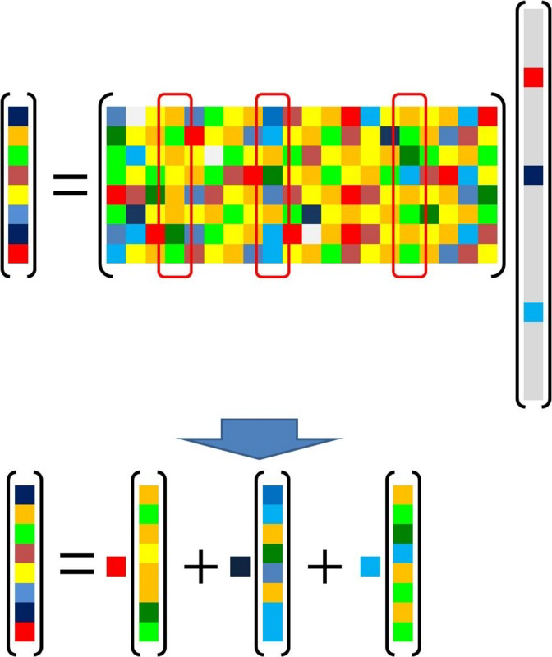
Sparse Coding
Sparse latent variables: e.g.
Notes:
http://d.hatena.ne.jp/takmin/20121224/1356315231

Slide 53
Sparse Autoencoders
Cost on h that penalizes code from being large
Regularization on output of encoder, not on network parameters
e.g. L₁ penalty |h|

Slide 54
Denoising Autoencoders
Trained with corrupted data points, but to reconstruct original data points
Corrupted copy of x

Slide 55
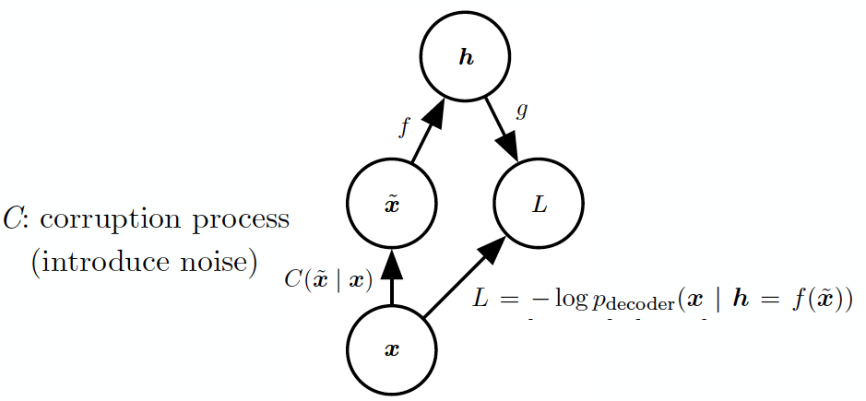
Denoising Autoencoders

Slide 56
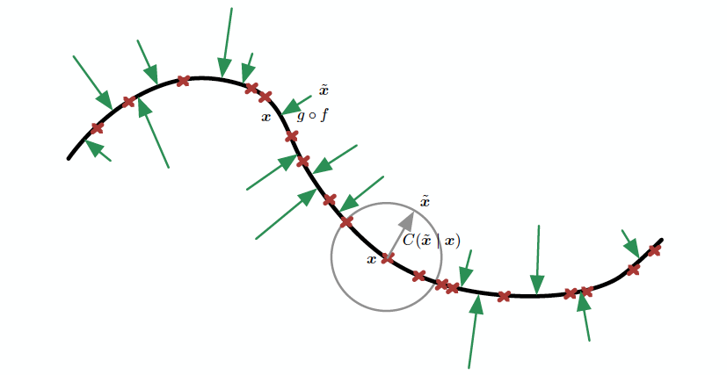
Denoising autoencoders learn a manifold

Slide 57
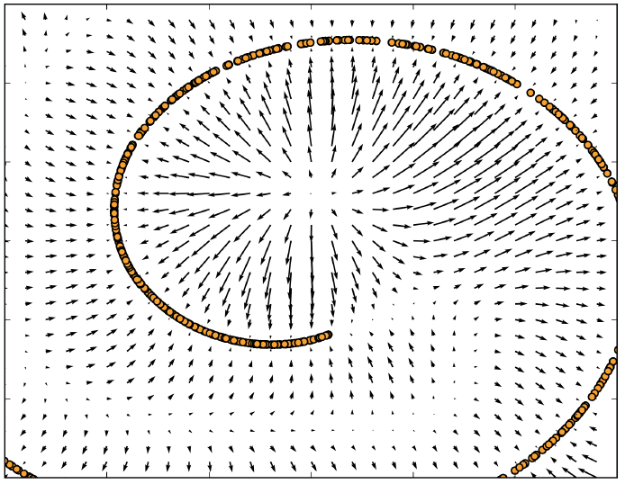
Vector field learned by denoising autoencoder Each arrow is proportional to g(f(x)) – x

Slide 58
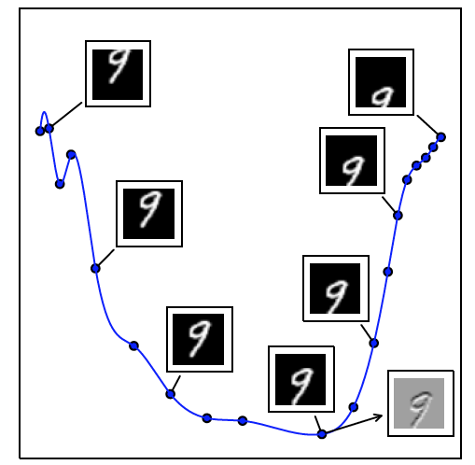
Tangent hyperplane of a manifold

Slide 59
Contractive Autoencoders
Penalizes derivatives of f
Makes encoder resistant to small perturbations in input
Identifies directions with most local variance

Slide 60
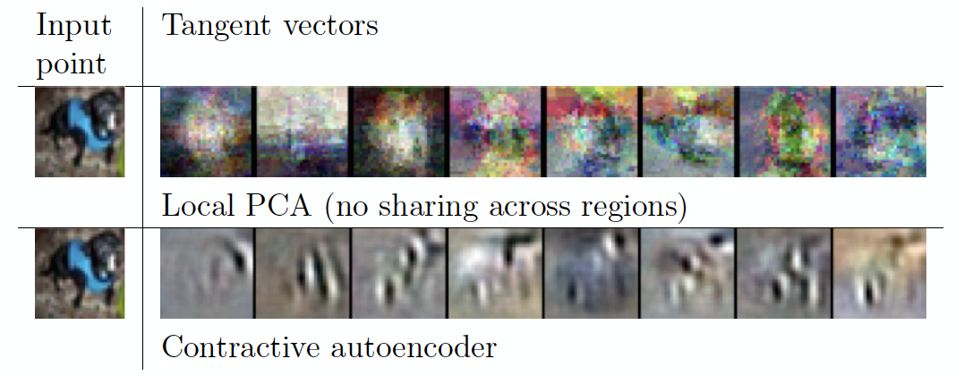
Contractive Autoencoders

